Slide 1

Squat Assessment Using Pose Estimation: A Rule-Based Framework for Fitness Applications
Presented by: Haya Aldawsari
Supervised by: Dr. Muzammil Behzad

Slide 2
Table of contents
01
Introduction
02
Literature Review
03
Methodology
04
Results and Analysis
05
Conclusion and Future Work

Slide 3
Introduction

Slide 4
Introduction
Squats are essential for fitness but often performed incorrectly.
Incorrect squat form risks injuries.
Automated real-time feedback systems are increasingly needed to ensure safe and effective squat performance.

Slide 5
Problem Statement
Existing pose estimation tools mainly detect body landmarks but do not evaluate squat form quality.
Most solutions need expensive hardware or provide limited feedback.
There is a need for a lightweight, real-time squat evaluation system using only a standard camera.

Slide 6
Literature Review

Slide 7
Overview of Existing Techniques
Pose estimation models like OpenPose and BlazePose enable real-time skeletal tracking.
Early exercise monitoring systems relied on wearable sensors or depth cameras.
Recent advancements allow 2D pose estimation using standard RGB cameras for fitness application.

Slide 8
Limitations in Existing Approaches
Rely on large annotated datasets and complex machine learning models, making them impractical for real-time use.
Provide landmark detection but often lack real-time, actionable feedback for correcting form.
Are not accessible or affordable for beginners and home users who need simple, practical solutions.

Slide 9
Methodology

Slide 10
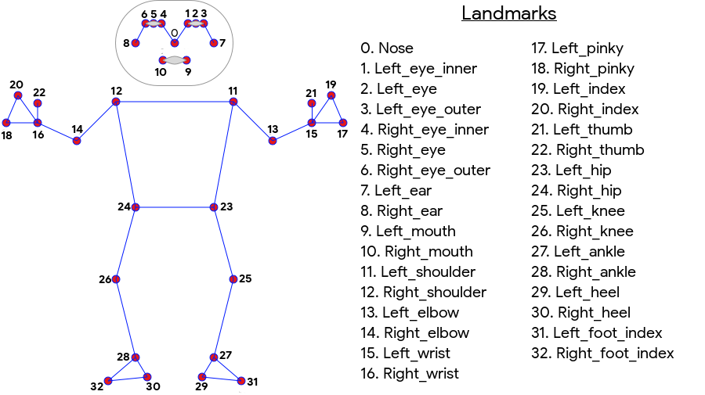
Existing Model and Challenges
MediaPipe BlazePose detects 33 human body landmarks from 2D video.
Focused on general body tracking, not specific exercise quality evaluation.
No built-in assessment of squat depth, posture correctness, or repetition counting.
Raw landmark outputs need further processing to interpret movement quality.

Slide 11
Performance Metrics
The system evaluates squat performance based on key biomechanical measurements extracted from joint angles.
The following thresholds are used for Beginner and Pro modes:
Metric | Beginner Mode | Pro Mode
Hip-Knee-Vertical (Squat Depth) | 10°–50° | 15°–50°
Ankle Angle (Dorsiflexion) | ≥ 45° | ≥ 30°
Knee Angle Transition | 50°–70°–95° | 50°–80°–95°
Back Offset Angle (Torso Lean) | 35° | 35°

Slide 12
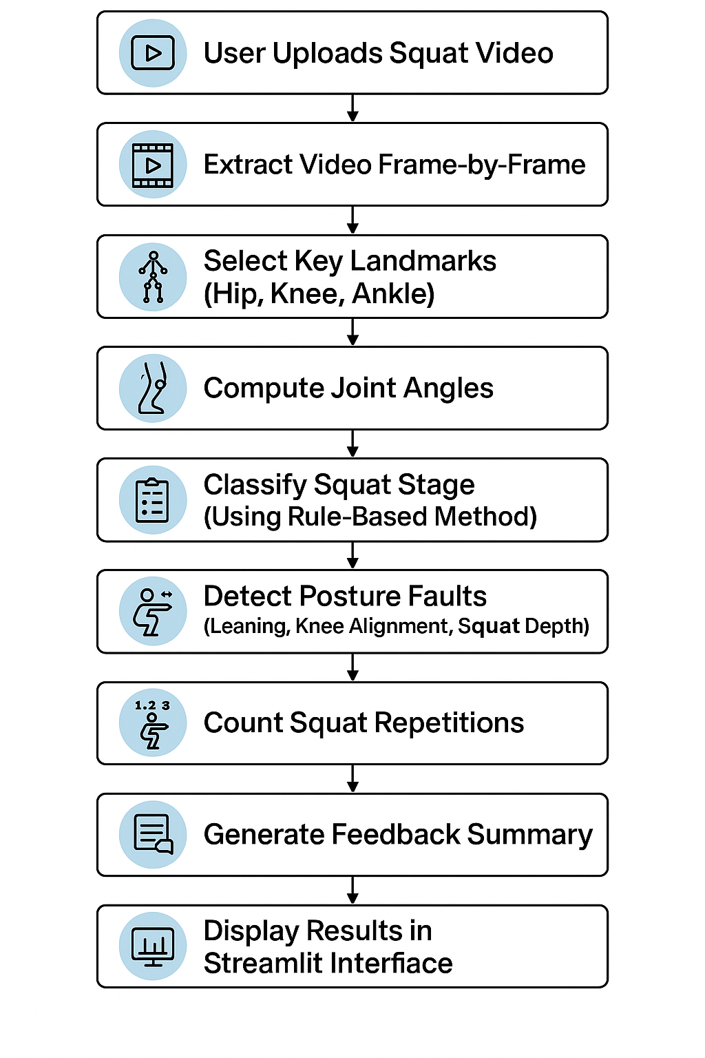
Algorithm and Implementation

Slide 13
Results and Analysis

Slide 14
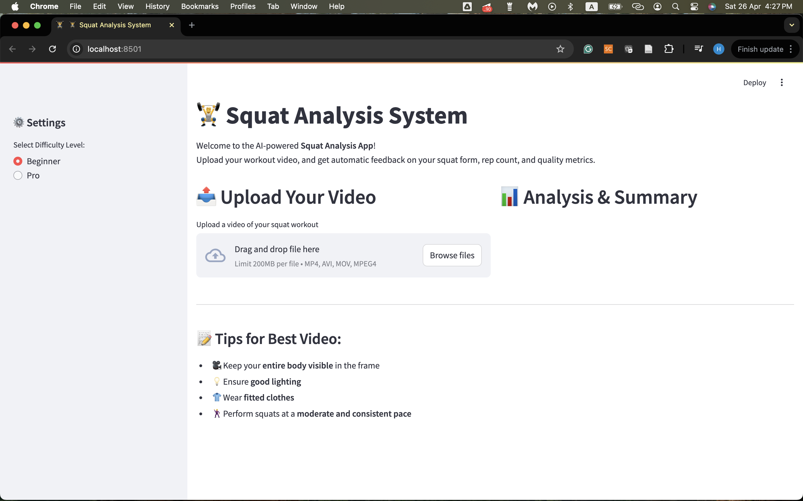
Experimental Results
Developed a complete user interface using Streamlit for video upload, squat evaluation, and feedback display.
Tested on 23 squat videos containing ~65 squat repetitions.

Slide 15
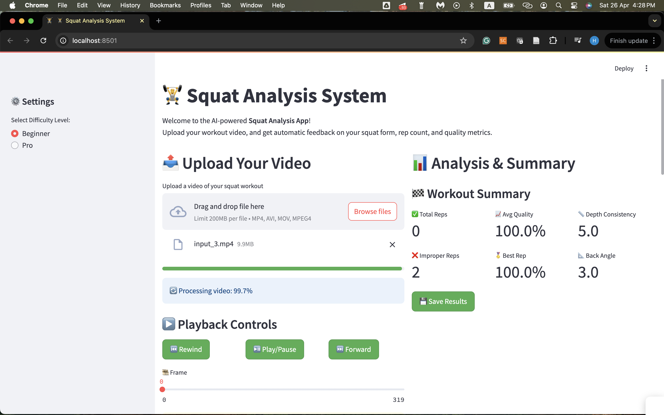
Experimental Results
Developed a complete user interface using Streamlit for video upload, squat evaluation, and feedback display.
Tested on 23 squat videos containing ~65 squat repetitions.

Slide 16
Experimental Results
Manual evaluation performed by an expert trainer. The model correctly detected 59 out of 65 squats. Achieved 90.77% per-repetition accuracy.
Video # | Total Squats | Model Detection Result | Expert Observation | Match
1 | 3 | 3 improper squats detected | Incorrect squats | Y
2 | 2 | No reps detected | Slightly above parallel, forward lean | Y
3 | 2 | 2 improper squats detected | Forward lean detected | Y
4 | 3 | 3 clean reps detected | Proper clean form | Y
5 | 5 | 5 improper squats detected | Excessive depth | Y
... | ... | ... | ... | ...
23 | 2 | 1 correct rep detected | 2 clean reps | N

Slide 17
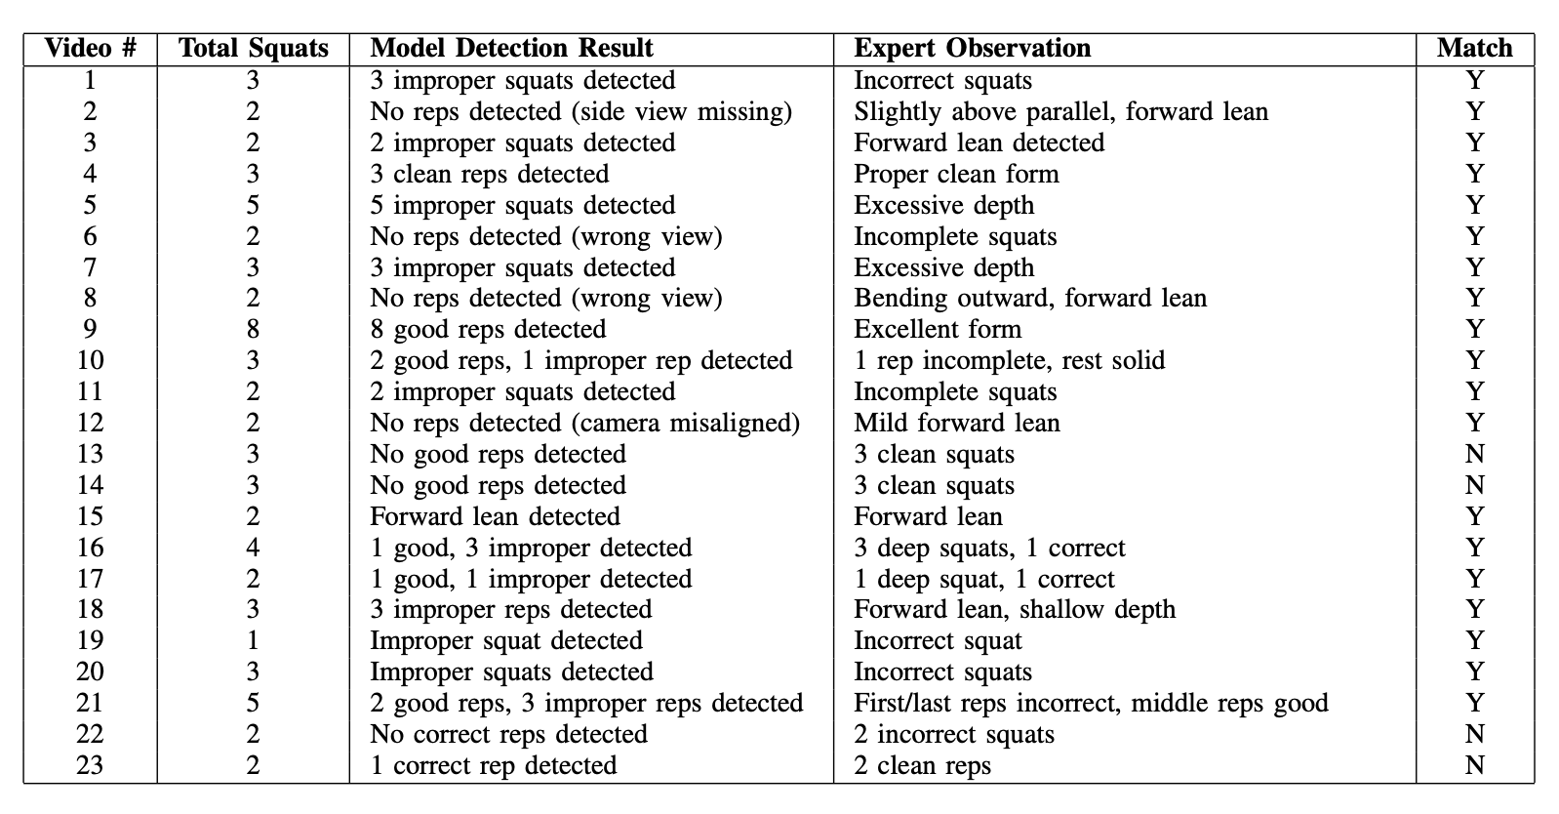
Experimental Results

Slide 18
Comparative Analysis
The following table compares our system with Hisham et al. (2022) across key aspects.
Feature | Proposed System | Hisham et al. (2022)
Pose Estimation Model | MediaPipe Pose (BlazePose) | MediaPipe Pose (BlazePose)
Analysis Approach | Frame-by-frame joint angle evaluation + detailed posture fault detection | Rule-based abnormality detection with smoothing
Dataset | 23 videos (~65 squat repetitions) | 20 videos (1 squat per video)
Viewpoint Requirement | Side view only | Side view only
Real-Time Capability | Yes (Streamlit CPU App) | No (offline analysis)
Feedback Detail | Rich feedback (repetitions, faults, consistency) | Simple binary classification (normal/abnormal)
Overall Accuracy | 90.77% | 85%

Slide 19
Conclusion and Future Work

Slide 20
Conclusion
Developed a real-time squat evaluation system based on 2D pose estimation. Provided detailed repetition feedback and posture fault detection. Built a user-friendly Streamlit web interface for easy access and real-time results.
Extend the system to evaluate other exercises (lunges, push-ups). Adapt dynamic thresholds based on user characteristics. Explore hybrid rule-based and machine learning approaches. Deploy a lightweight mobile application for broader accessibility.
Future Work

Slide 21
Thank You!
Do you have any questions?

